Slide 1

SWEN 755: Software Architecture
Architecture Breakers
Viktoria Koscinski

Slide 2
What are architecture breakers?
Mistakes in implementing an architecture which can prohibit the full benefits of design decisions, or make the underlying tactic, pattern or style incorrect and useless.
Architecture breakers range from simple coding mistakes (exceptions, in tactical code) to more conceptual mistakes (weak encryption technique, or mismatches between heartbeat send and checking periods)

Slide 3

Architecture Breaker
Developer #1: DataNode.java, should send several messages to the NameNode.java. Messages such as block reports, heartbeat, blocks to be deleted etc.
NameNode.java
…
c) block to be deleted
b) block reports
a) HeartBeat
DataNode.java
Data
Data
Data
Data
Data
Issues Reported: HADOOP-4584, HADOOP-178,…
Notes:
This is a real-world example. You can look up the “issues reported” (Hadoop-4584 and Hadoop-178) for more information.

Slide 4

Architecture Breaker
Developer #2: So many messages, lets merge them by piggy-backing
NameNode.java
c) block to be deleted
Design Decay & Compromising Availability: Block reports are usually delayed, system detects the DataNode failure and lunches the recovery process while it is alive.
…
Piggy Backing Heartbeat message on block reports
b) block reports
a) HeartBeat
a,b,c,…
DataNode.java
Data
Data
Data
Issues Reported: HADOOP-4584, HADOOP-178,…
Notes:
Due to the message delay, heartbeat doesn’t get there on time, and the monitor thinks the system is down when it’s not.

Slide 5
Architecture Breaker
Developer #3: every 10 seconds, DataNode.java reports data or sends an empty message for heartbeat
NameNode.java
a.b.c….
If (t==10 & BlockReady)
report(b);
else report(Empty);
DataNode.java
Data
Data
Data
Issues Reported: HADOOP-4584, HADOOP-178,…

Slide 6
Architecture Breaker
NameNode.java
Developer #4: lets make it every 2 seconds
a.b.c….
If (t==2 & BlockReady)
report(b);
else report(Empty);
Design Decay & Performance Tradeoff: Performance issues, tradeoff between availability and performance
DataNode.java
Data
Data
Data
Issues Reported: HADOOP-4584, HADOOP-178,…
Notes:
Tradeoffs aren’t always breakers. However, when you are starting to have unnecessary tradeoffs due to poor design choices, then that becomes a breaker.

Slide 7
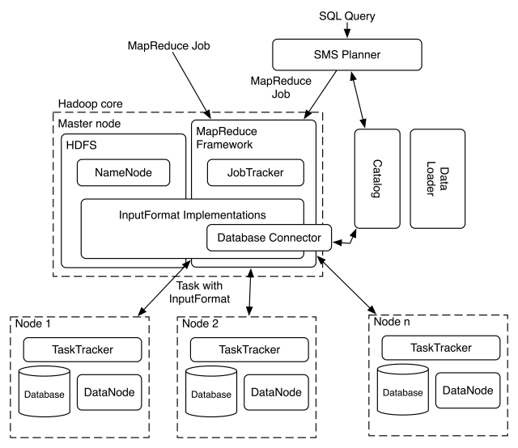
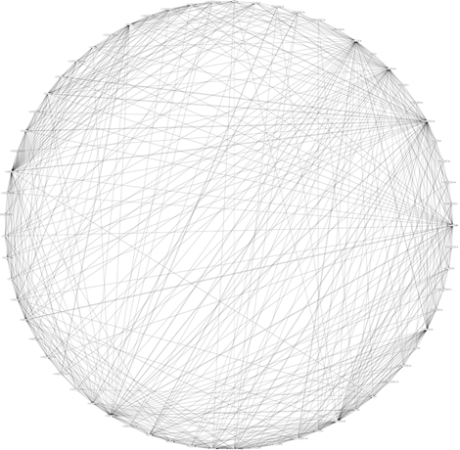
Architectural Decay
Master
Read more about the “big ball of mud” anti-pattern:
http://www.laputan.org/mud/mud.html#BigBallOfMud
https://citeseerx.ist.psu.edu/document?repid=rep1&type=pdf&doi=f0f64c66c0233a73bd1ea39e6c97879201a1dbc3
HB
HB
HB
Slave
A big ball of mud: Apache Hadoop architecture
Notes:
A high-level architecture of a Hadoop-based distributed system, particularly focusing on the MapReduce framework.
The Big Ball of Mud is an architectural anti-pattern characterized by a lack of clear structure and organization.
Simply speaking, you get a big ball of mud when each element has a dependency with other elements. You can see a graph of the dependencies from well-known open-source project Apache Hadoop. In order to visualize the big ball of mud (or rather, the big ball of yarn), you draw a circle and place classes from the project evenly on it. Just draw a line between each pair of classes that depend on each other. All of these dependencies introduce a lot of complexities into the system.
Issues from this may arise by making changes in the system. By making a change in one place, you can introduce unpredictable behavior somewhere else. This means you have high coupling, and therefore lowered modifiability.

Slide 8


Implementing a Design is Difficult
An Observation: developers have difficulties implementing tactics/ patterns/styles. They keep refactoring…
Intended Architecture
More Facts : In one study of five large scale software systems, Tactic-related classes had significantly more bugs than non tactic-related ones (p-value< 0.001).
Implemented Architecture
Notes:
Remember: architectural tactics help influence the quality attribute response.
This is another example of functionality taking precedence over quality attributes.

Slide 9
Implementing a Design is Difficult
Non-Architecture Savvy Developers tend to introduce more bugs in Design Fragments of the system (p-value< 0.01).
Architecture Savvy Developers are less likely to step on one another's toes even collaborating on the same source file.
Notes:
Remember: architectural tactics help influence the quality attribute response.
This is another example of functionality taking precedence over quality attributes.

Slide 10

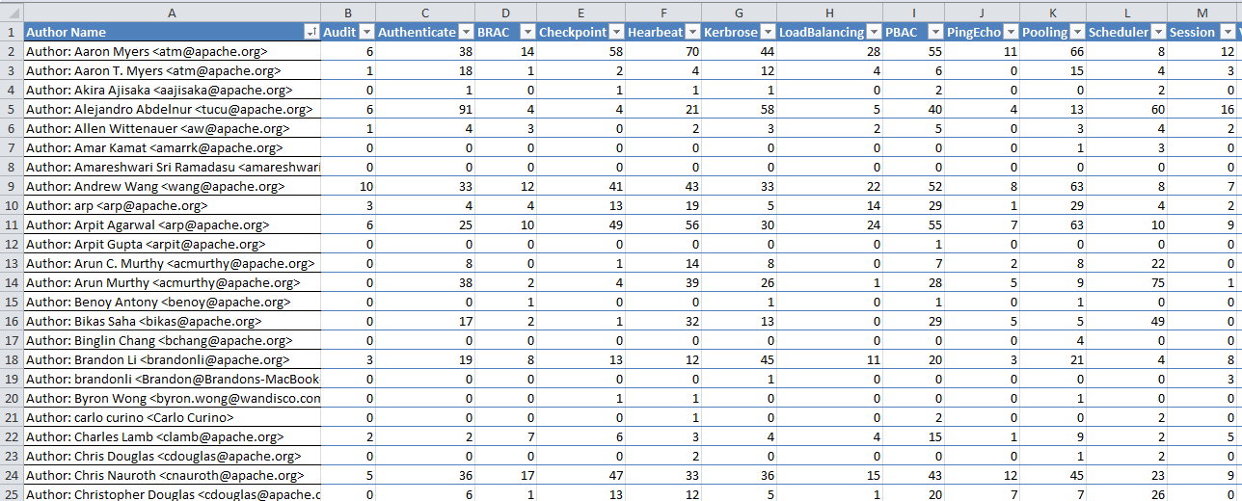




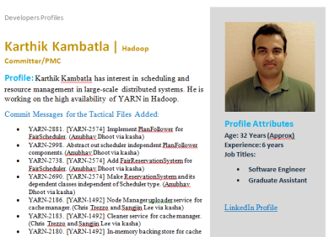

Architecture Savvy Developers
Developers’ Contribution to the Design Fragments
Non-Architecture Savvy Developers tend to introduce more bugs in Design Fragments of the system (p-value< 0.01).
Architecture Savvy Developers are less likely to step on one another's toes even collaborating on the same source file.

Slide 11
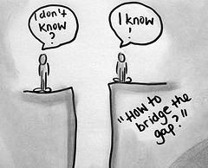
Mind The Gap!
Notes:
The question comes up of how do we bridge the gap. The problem is that usually we only know the answer once we are already on the other side.
The next few slides discuss some ways of reducing architecture breakers, namely through being an architecture savvy developer.

Slide 12
Architecture Breakers
Mistakes in implementing an architecture which can prohibit the full benefits of design decisions, or make the underlying tactic, pattern or style incorrect and useless.
Architecture breakers range from simple coding mistakes (exceptions, in tactical code) to more conceptual mistakes (weak encryption technique, or mismatches between heartbeat send and checking periods)
Notes:
Going back to what are architecture breakers…

Slide 13
Architecture Breakers
Why should you care?
Architecture breakers help us in developing test cases for our tactics.
What can go wrong with the implementation of my tactic?
How can I benefit from test-driven development in implementing my architecture?
Notes:
One way we can help reduce architecture breakers is by developing test cases specifically for our architectural tactics. So, not just for functionality.
Here, you have to think about what those breakers can be…

Slide 14
Architecture Breakers
Example: Heartbeat Tactic
Heartbeat Sender and Receiver are on different process.
And there is a mismatch between send and receive periods.
HB Sender has failed but Receiver doesn’t detect that.
Example: Thread Pooling
Threads are not reset before reuse.
Issues related to thread-safety.
Lazy Load vs Eager Load.
Notes:
When a thread is reused without proper resetting, it may retain stale or inconsistent state from its previous execution, leading to unpredictable behavior.
When multiple threads access shared resources without proper synchronization, race conditions, deadlocks, or data corruption can occur.
Thread pooling may involve loading resources either lazily (on-demand) or eagerly (all at once). In cases where eager loading occurs in a thread-pooling system, resources can be unnecessarily consumed, leading to inefficiency.

Slide 15
Architecture Breakers
Example: Secure Session Management
Authentication failure
Authorization failure
Bugs in Encryption of Session data
Predictable Session ID properties, entropy and length
Hardcoded cookies
Notes:
Sometimes, an architecture breaker can consist of multiple “parts”/conditions breaking it, other times it is just one “part” that breaks it.

Slide 16
Architecture Breaker and Architecture Testing
Test-Driven Development of Tactics
Identify potential architecture breakers.
Develop test plans.
For each breaker, write test-cases and then develop the source code.
HeartBeat Example:
(1) Verify whether the Sender sends messages at the sendingInterval rate.
(2) Verify if an injected failure stops the messages being sent.
(3) Verify whether the receiver detects that no message at all was sent from the sender.
(4) In this situation, the receiver shall notify the monitor after the EXPIRING_INTERVAL was reached.
(5) Verify whether the receiver correctly detects that the sender sent some messages previously. In this case, the receiver should detect the sender as alive until it stops sending messages and the EXPIRING_INTERVAL was reached.
Notes:
Identifying potential architectural breakers is not easy: you have to think about the architectural or QA goals you want to achieve, ensure you are using good design principles, and identify where extra complexity can occur…

